Slide 1
Visa and Registration Centre
Office of Internationalisation
VISA & REGISTRATION
Highlights
Moscow, 2019

Slide 2
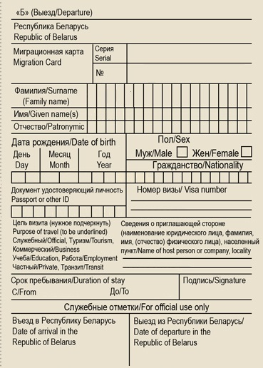
Visa and Registration Centre
Office of Internationalisation
MIGRATION CARD
Passport control
Always
keep it with you
Departure
Education
must be underlined as a purpose of entry

Slide 3
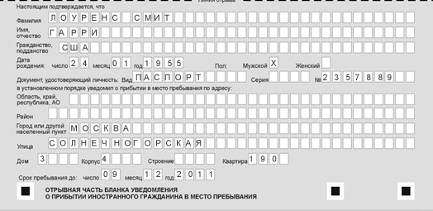
Visa and Registration Centre
Office of Internationalisation
REGISTRATION
WHEN TO APPLY?
On the next day upon arrival
WHAT DOCUMENTS?
copy of passport (all pages with marks, stamps, visas) including visa
copy of migration card
additional documents may be required (an HSE request )
WHEN TO PICK IT UP?
in 5 working days after submitting

Slide 4
HOW TO APPLY FOR REGISTRATION
dormitory
apartment
Landlord
Passport specialist
“Passportist”
request form from HSE University
local territorial body of the Russian Ministry of Internal Affairs
Higher School of Economics University, Moscow, 2019

Slide 5
REGISTRATION
Original Registration
Fake Registration
Free of charge and made by a local migration office
The address on the registration slip is the same as your place of residence in Russia
The dates on the registration slip are the same as the dates of your current visa
Don`t pay for registration
The registration slip is made by a third party
Different addresses on the registration slip and where you stay in Russia
The date of the expiration of your registration is later than your visa expires
Higher School of Economics University, Moscow, 2019

Slide 6
Visa and Registration Centre
Office of Internationalisation
TRAVELING ACROSS RUSSIA and YOUR REGISTRATION
ATTENTION!
If you travel across Russia and
you get new registration in hostels, hotels, etc.,
upon your return to Moscow you must reapply for registration within 2 days (for more details see slide “REGISTRATION”).
Foreign citizens who violate the immigration regulations shall be subject to a fine and may be deported from Russia on the basis of a court decision

Slide 7
MULTIPLE-ENTRY VISA
LIST OF DOCUMENTS
copy of passport (all pages with marks, stamps, visas)
copy of visa
migration card (original + copy)
registration slip (original + copy of both sides)
1 color photo 3,5 x 4,5 cm
visa extension fee payment receipt (1600 Rubles)
for full-degree students – request it from your study office
copy of tuition agreement (for fee-paying students, you can get it from your program manager)
copy of your quota referral (for quota degree-seeking students, you can get it from your program manager)
order of enrollment (you can get it from your program manager)
WHEN APPLY?
no later than 45 calendar days before your visa expires
photo
HOW TO APPLY?
deliver in person to Preparatory Year Program manager
WHEN TO PICK UP?
Visa & Registration Centre will inform Preparatory Year Manager when it will be ready.
NEW REGISTRATION
As soon as you get your new multiple-entry visa you must apply for new registration at place of your residence (dormitory or apartment) immediately.
photo
Higher School of Economics, Moscow, 2018

Slide 8
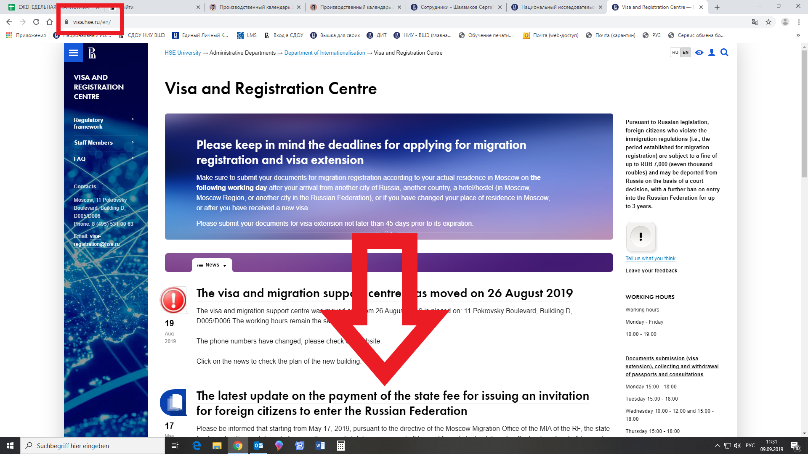
Our website

Slide 9
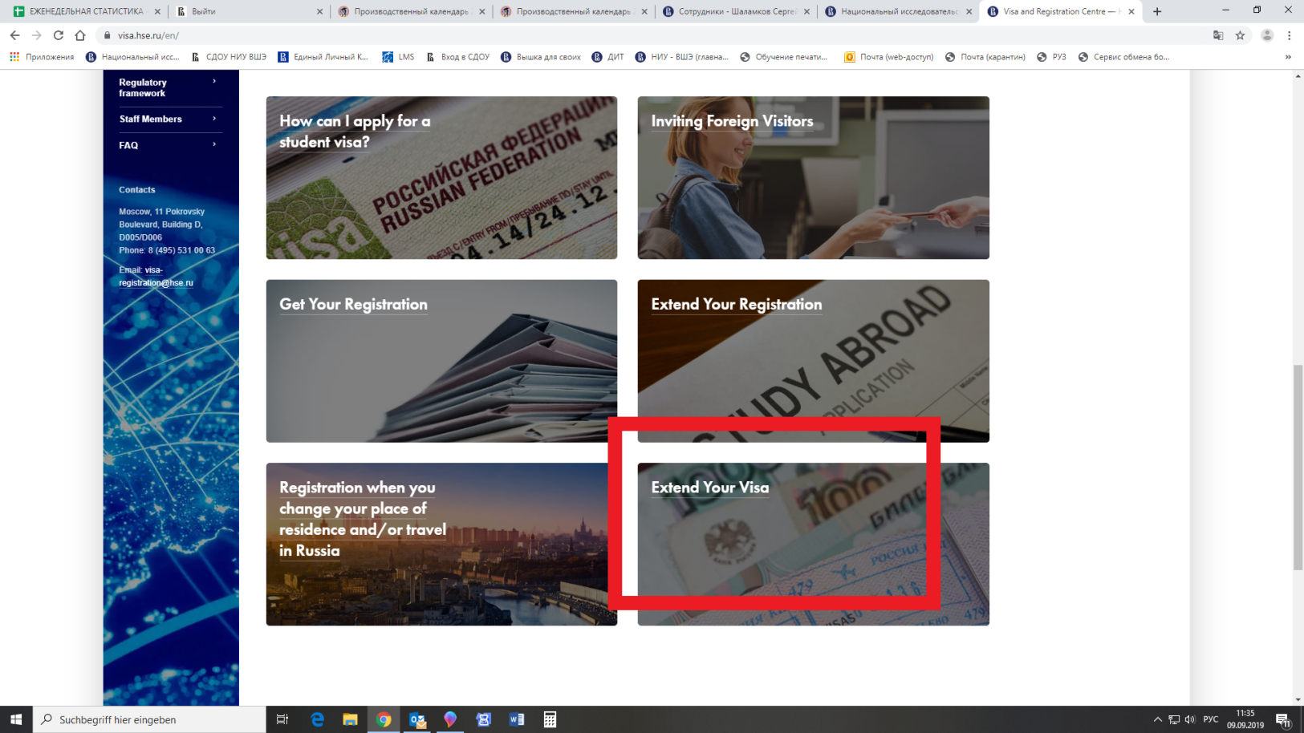
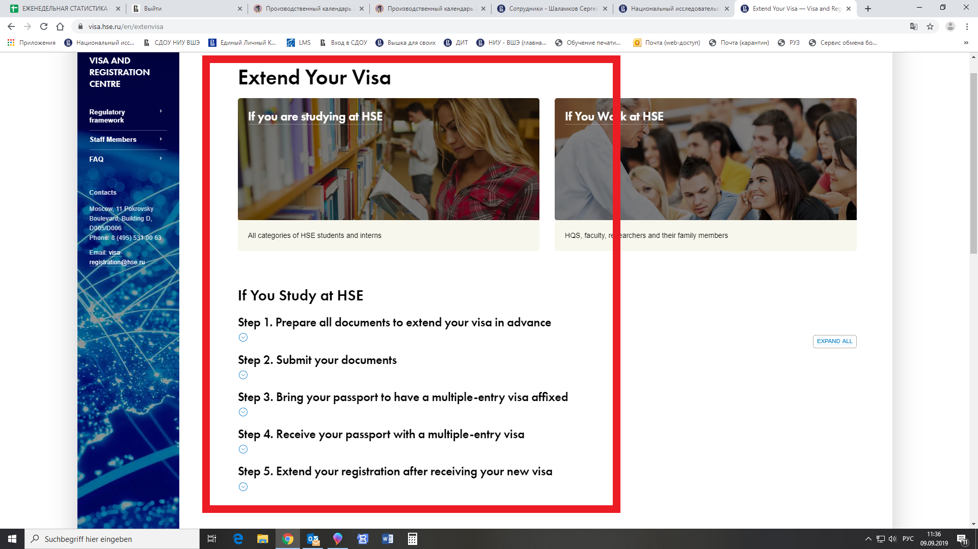
Our website

Slide 10
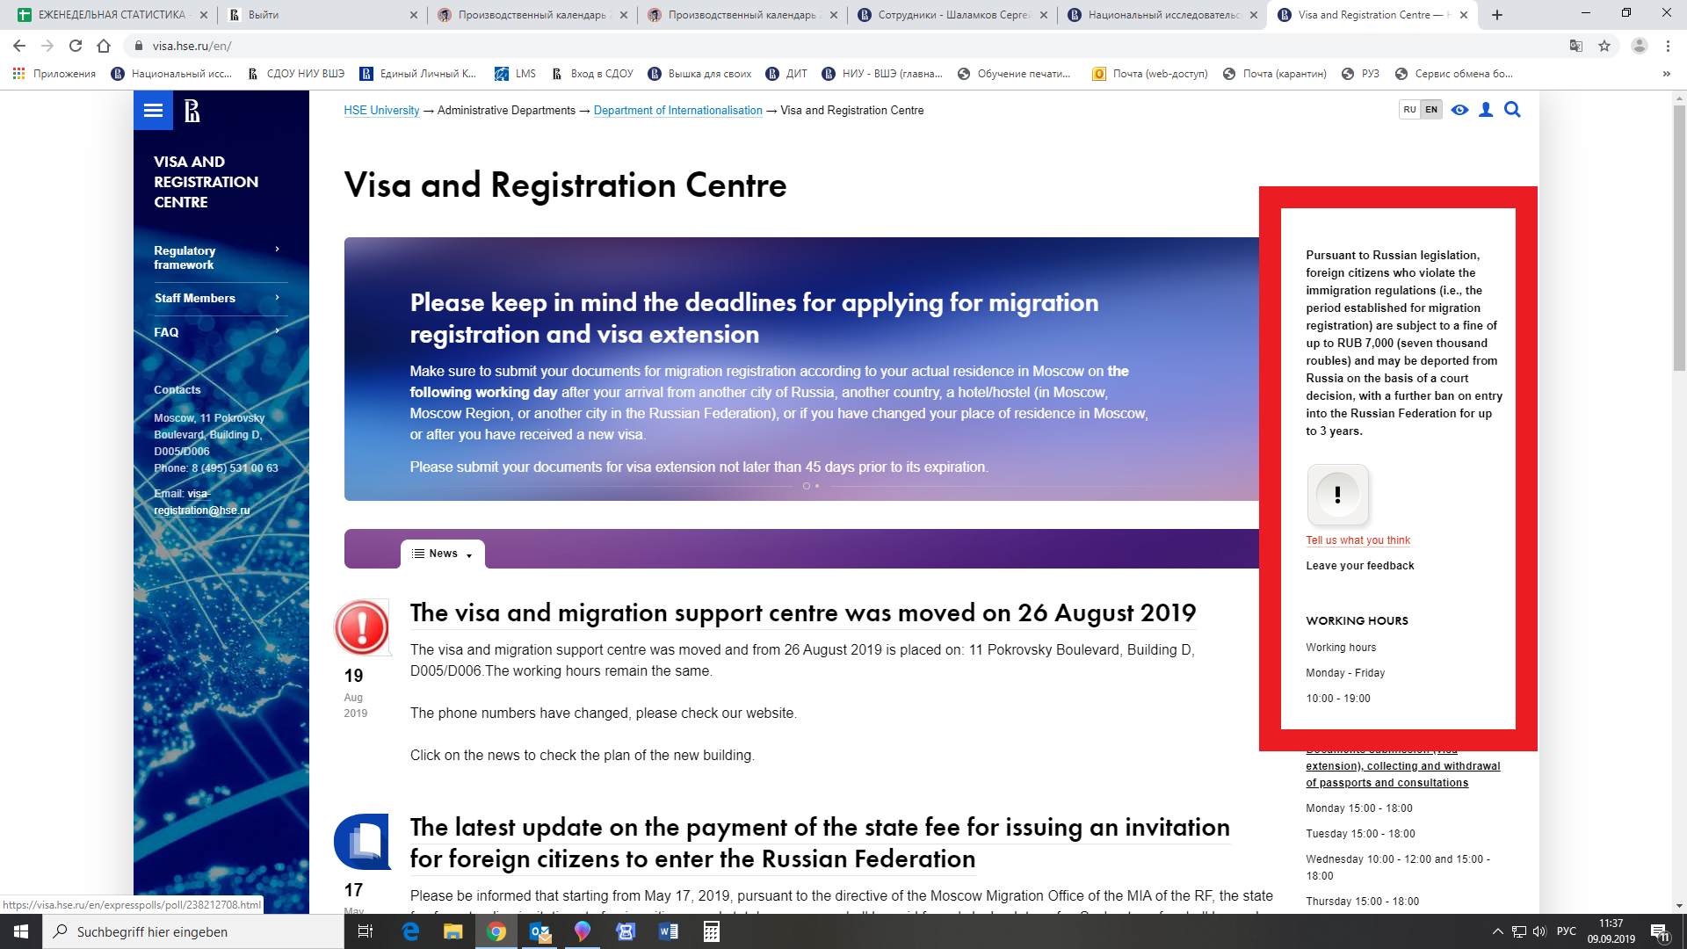
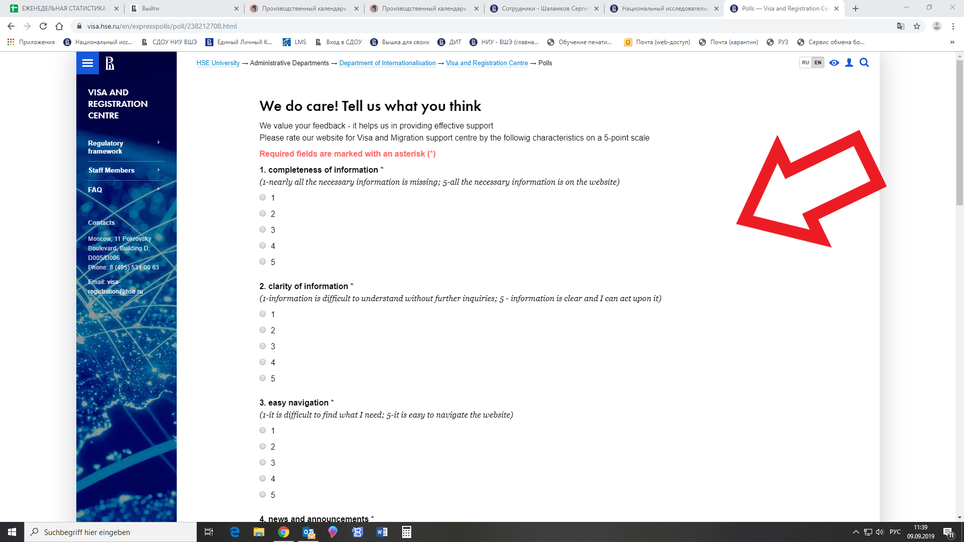
Our website

Slide 11
Visa and Registration Centre
Office of Internationalisation
HSE Visa & Registration Centre:
CONTACT DETAILS
for more information please visit our website: https://visa.hse.ru
Office hours: Monday-Friday,
10:00 am-7:00 pm
Visiting hours:
Monday, Tuesday, Thursday- 03 pm - 06 pm
Wednesday, Friday -
10:00 a.m. -12-00 and
03 pm - 06:00 pm.
If you have questions, please visit our website or/and contact us at:
email: visa-registration@hse.ru
Address: 11 Pokrovsky Boulevard, Building D (2E), D006

